Slide 1

DEPARTMENT OF COMPUTER SCIENCE AND ENGINEERING
EcoSort Intelligence: Smart E-Waste Classification & Economic Optimizer
Name of students:
Akshay Prashad : 210171601007
Kamal V: 210171601021
Supervisor:
Dr. S.P.Valli Associate Professor
Domain of project : Artificial Intelligence

Slide 2
DEPARTMENT OF COMPUTER SCIENCE AND ENGINEERING
EcoSort Intelligence: Smart E-Waste Classification & Economic Optimizer
Description :
EcoSort Intelligence is an innovative framework that leverages deep learning (ResNet, EfficientNet) for automated, accurate classification of e-waste components and market basket analysis (MBA) to predict the economic viability of recycling versus reuse.
By optimizing resource recovery and prioritizing high-yield component clusters, it enhances sustainability, reduces environmental impact, and maximizes profitability in e-waste management.

Slide 3
DEPARTMENT OF COMPUTER SCIENCE AND ENGINEERING
Abstract
Automated Component Classification: Utilizes deep learning models (ResNet, EfficientNet) to accurately identify and count laptop parts, streamlining e-waste sorting.
Market Basket Analysis (MBA): Analyzes historical data to uncover component co-occurrence patterns and predict recycling vs. reuse outcomes.
Economic Descriptive Modeling: Evaluates costs, market values, and conditions to determine the most profitable processing strategy for e-waste.
Sustainability & Circular Economy: Promotes resource recovery and reduces environmental impact by optimizing high-yield component clusters and advancing sustainable e-waste practices.
ZETA

Slide 4
DEPARTMENT OF COMPUTER SCIENCE AND ENGINEERING
Existing and proposed work
Aspect | Existing Work | Proposed Work
AI Techniques | Various models like CNNs, AlexNet, Inception, and hybrid transfer learning | Deep learning with ResNet and EfficientNet for precise classification
Prediction Focus | E-waste classification and sorting, waste generation prediction | Market Basket Analysis (MBA) and profits for economic feasibility of E- Waste companies of recycling vs. reuse
Accuracy | Models achieve accuracy between 83% to 99.1% in different use-cases (Smart Phone classification, Electrical Screwdrivers etc.) | It has both deep learning (Pc components) and MBA for optimal component clustering and decision-making
Sustainability | Emphasizes automation for efficiency and AI-driven classification | Optimizes e-waste processing by prioritizing high-yield clusters, promoting cost-effectiveness
Circular Economy | Uses AI for better e-waste identification and sorting | Advances circular economy with integrated component classification and predictive analytics
ZETA

Slide 5
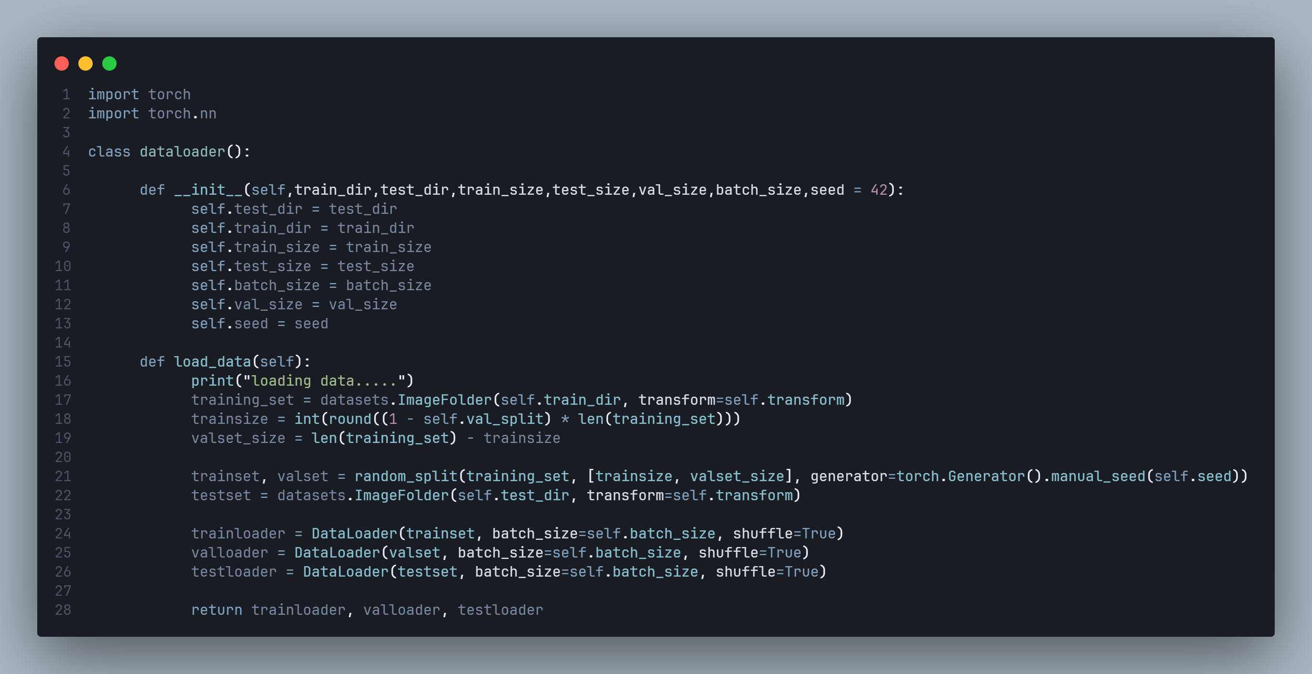
DEPARTMENT OF COMPUTER SCIENCE AND ENGINEERING
IPO
Input:
Images of components
Component Details:
Type: (CPU, GPU, RAM, PSU, SSD, etc.)
Brand & Model: (e.g., Intel i7-8700, RTX 3060)
Condition: (New, Used, Damaged, Repairable)
Age: (Number of years since purchase)

Slide 6
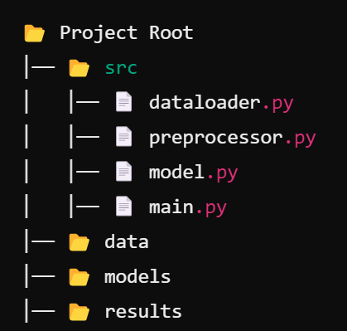
DEPARTMENT OF COMPUTER SCIENCE AND ENGINEERING
IPO
Process: Algorithms Service - 1
1. Preprocessor (preprocessor.py)
Image preprocessing (denoising, contrast adjustment)
Extract features if needed
Data augmentation (rotation, flipping, cropping)
2. Dataloader (dataloader.py)
Load images & labels (classification + count)
Apply transformations (resize, normalize, augment)
Create PyTorch Dataset & DataLoader
3. Model (model.py)
Load pre-trained ResNet / EfficientNet models
Modify output layer for classification & counting
Define loss function & optimizer
4. Main (main.py)
Load dataset & initialize model
Train, validate, and test
Save best model & generate reports

Slide 7
DEPARTMENT OF COMPUTER SCIENCE AND ENGINEERING
IPO
Process: Algorithms Service- 2 (Profit analysis)
1. User Input → Component details (Type, Brand, Condition, Age).
2. Market Data Collection → Fetch resale prices, metal values, repair & recycling costs.
3. Profit Calculation →
Reuse Profit = Resale Price - (Repair + Logistics).
Recycle Profit = Extracted Material Value - Processing Cost.
5. Decision Making → Suggest Resale or Recycling based on higher profit.
6. Future Price Prediction → Use Machine Learning (ARIMA, LSTM) for trends.
7. Final Output → Display best profitability option & suggested action.
8. Check for updated prices → Using scrapers and api find the current market price and update the model.

Slide 8
DEPARTMENT OF COMPUTER SCIENCE AND ENGINEERING
IPO
Process: Algorithms Service - 2 (MBA)
Data Collection → Analyze past purchases & frequently bought items.
Pattern Mining → Use Apriori / FP-Growth to find best-selling combos.
Confidence & Lift Scores → Rank purchase trends.
Recommendation Generation → Suggest best PC component bundles for buyers.
Final Output → Show “Frequently Bought Together” in a table format.

Slide 9
DEPARTMENT OF COMPUTER SCIENCE AND ENGINEERING
IPO
IPO
Output: Performance evaluation measure
Metric | Description | Purpose
Profit Prediction Accuracy | Measures how accurately the system predicts whether recycling or reusing is more profitable. | Evaluate the reliability of profitability predictions.
Precision (for Reuse/Recycle/Image classification) | Measures the proportion of correctly predicted profitable reuse or recycle decisions. | Assess the accuracy of reuse vs. recycle decision-making.
Confidence and Support Vector(Market Basket Analysis) | Measures how much more likely two components are bought together than expected by chance. | Evaluate the strength of association between items.
AUC (Area Under ROC Curve) | Measures the area under the Receiver Operating Characteristic curve. | Evaluate the trade-off between true positives and false positives in classification.

Slide 10

IPO
Output: Performance evaluation measure
Metric | Description | Purpose
Processing Time (System Efficiency) | Time taken to process input data and generate results for profitability and market analysis. | Assess system performance and user experience.
F1 score | Harmonic mean of precision and recall to provide a balanced measure. | Evaluate the balance between precision and recall.

Slide 11
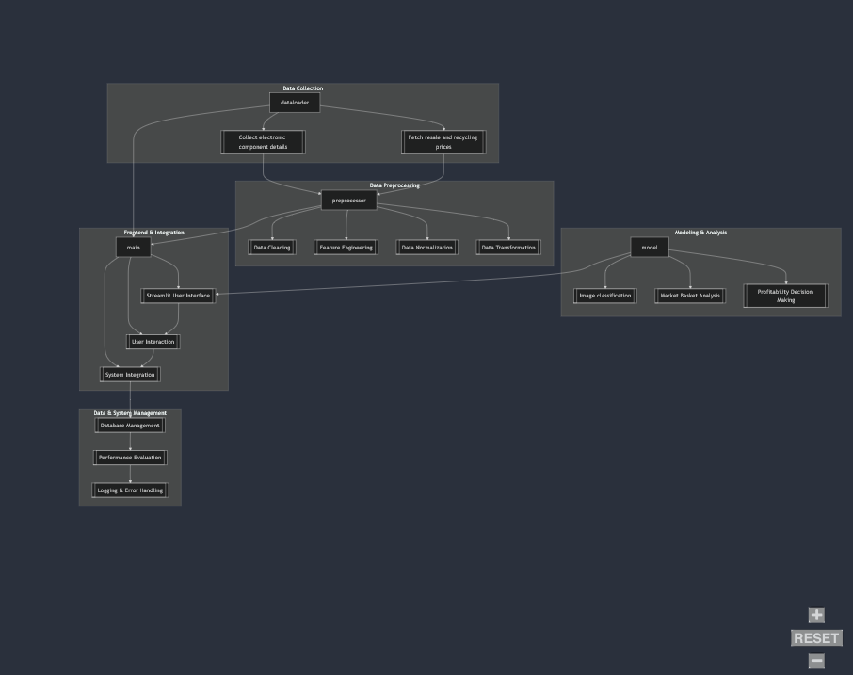
DEPARTMENT OF COMPUTER SCIENCE AND ENGINEERING
Architecture Diagram

Slide 12
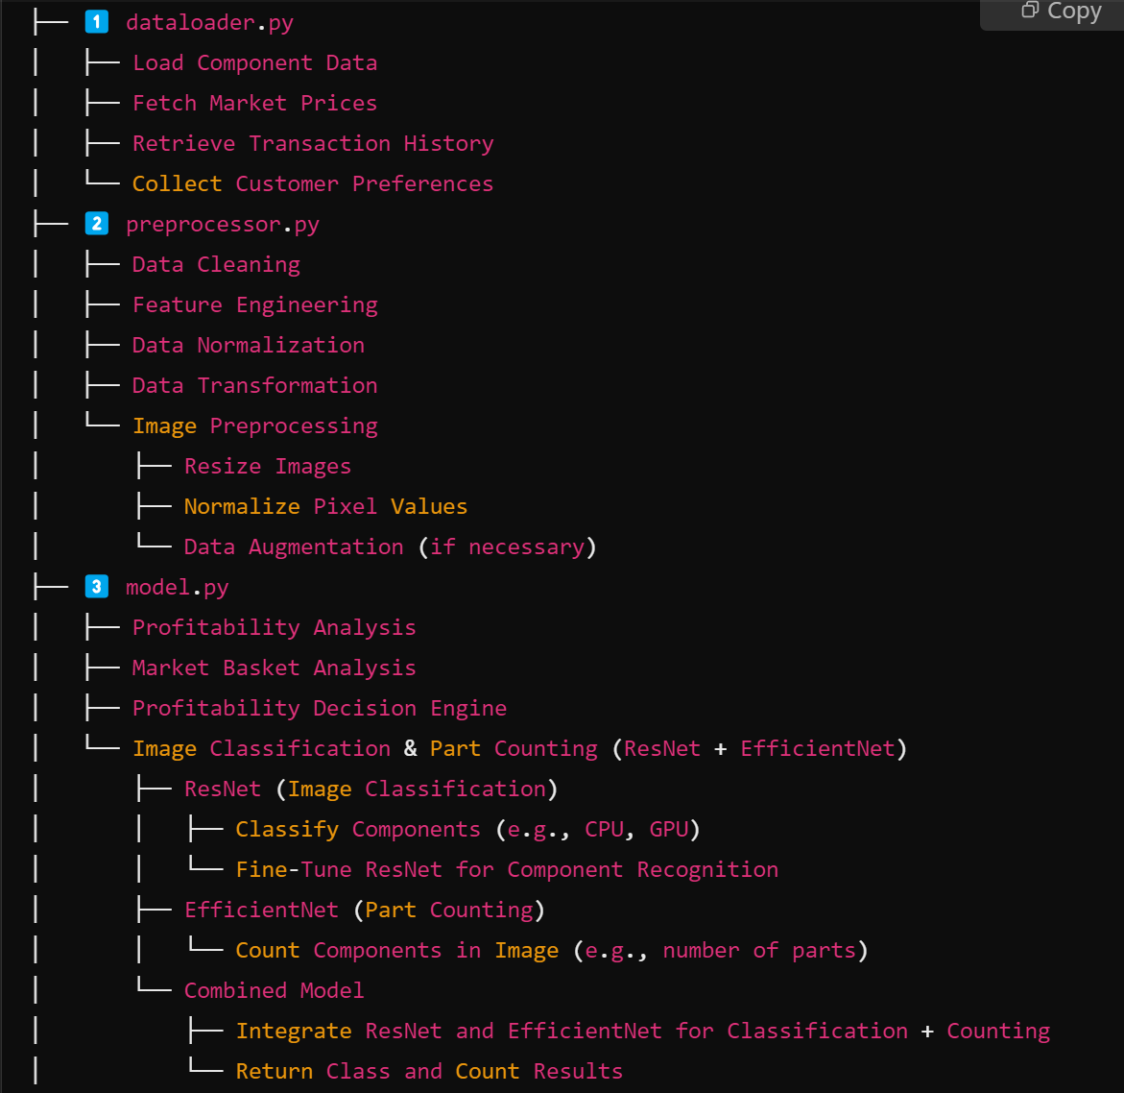
Modules
DEPARTMENT OF COMPUTER SCIENCE AND ENGINEERING

Slide 13
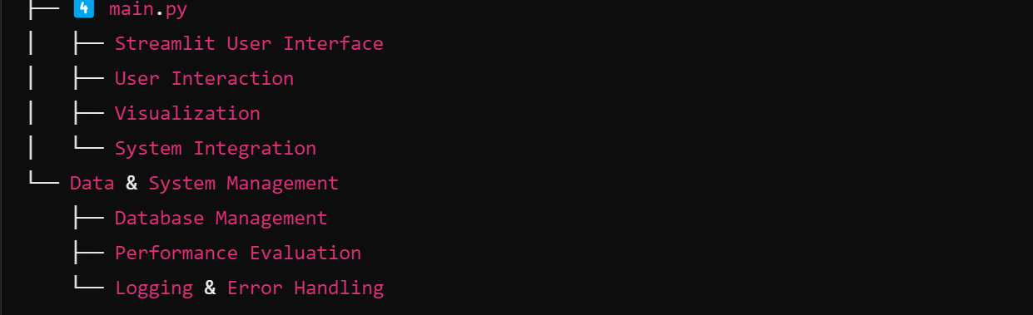
Modules
DEPARTMENT OF COMPUTER SCIENCE AND ENGINEERING
Other Utilities
Pure-Eval: For evaluation (used indirectly via ipython).
Markdown-It-Py : For markdown processing.
Pygments : For syntax highlighting.
Threadpoolctl : For thread pool control.

Slide 14
DEPARTMENT OF COMPUTER SCIENCE AND ENGINEERING
Software
1. Programming Language:
Python, , go (Optional)
2. Data Handling & Analysis:
Pandas, NumPy
Scikit-learn (for market basket analysis)
3. Deep Learning Libraries:
PyTorch (for ResNet, EfficientNet)
4. Image Processing:
OpenCV, Pillow
5. Market Basket Analysis:
mlxtend (for Apriori algorithm)
6. Web Interface:
Streamlit/HTMX
7. Database/Storage:
SQLite / MySQL / PostgreSQL / MongoDB
8. Version Control:
Git (GitHub, GitLab, or Bitbucket)

Slide 15
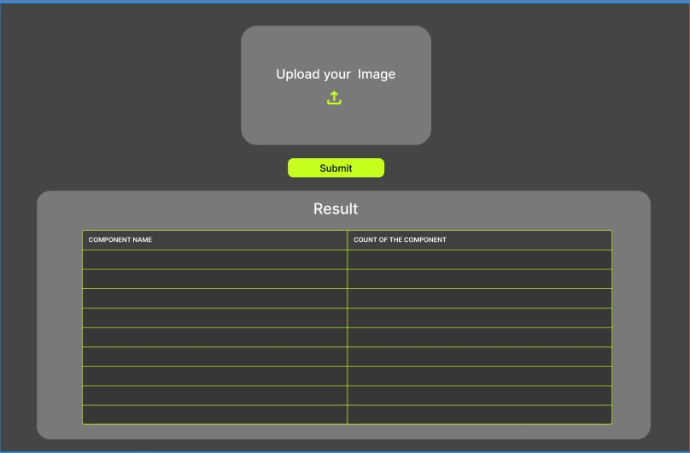
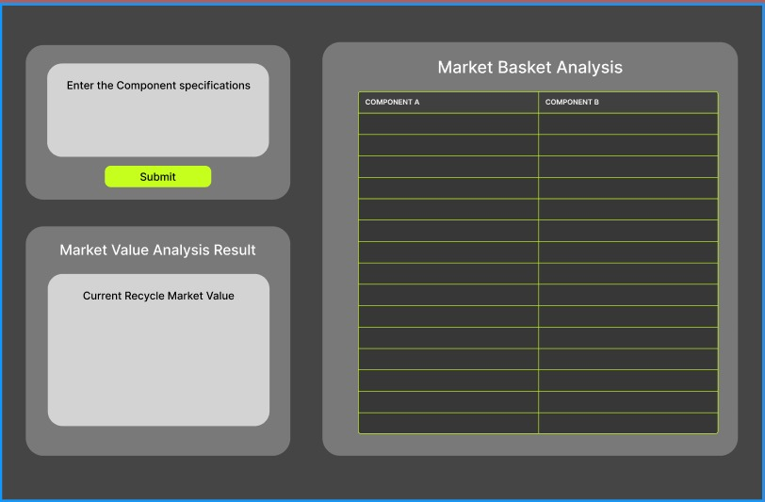
DEPARTMENT OF COMPUTER SCIENCE AND ENGINEERING
Front End Design

Slide 16
DEPARTMENT OF COMPUTER SCIENCE AND ENGINEERING
Reference
Abou Baker, N., Stehr, J., & Handmann, U. (2022). Transfer learning approach towards a smarter recycling. Neural Computing and Applications, 34(Issue), 12345–12360
Li, Haomiao, Zian Jin, and Sujatha Krishnamoorthy. "E-waste management using machine learning." Proceedings of the 6th International Conference on Big Data and Computing. 2021.
Abou Baker, Nermeen, Paul Szabo-Müller, and Uwe Handmann. "Transfer learning-based method for automated e-waste recycling in smart cities." EAI endorsed transactions on smart cities 5.16 (2021): e1-e1.
Sarkhoshkalat, Mohammad Mahdi, et al. "Circular Economy and the Recycling of E-Waste." New Technologies for Energy Transition Based on Sustainable Development Goals: Factors Contributing to Global Warming. Singapore: Springer Nature Singapore, 2024. 319-354.
Russo, Giorgio L. "Integrated Management of Electronic and Electric Waste (EEW) with the Application of Artificial Intelligence (AI): Future and Challenges." Advanced Technologies for Solid, Liquid, and Gas Waste Treatment. CRC Press, 2023. 23-40.

Slide 17
DEPARTMENT OF COMPUTER SCIENCE AND ENGINEERING
Reference
Selvakanmani, S., et al. "Optimizing E-waste management: Deep learning classifiers for effective planning." Journal of Cleaner Production 443 (2024): 141021.
Moradi, Rosita, et al. "Sustainable resilient E-waste management in London: A circular economy perspective." Heliyon 10.13 (2024).
Oise, Godfrey Perfectson, and Susan Konyeha. "Deep learning system for e-waste management." Engineering Proceedings 67.1 (2024): 66.
BAYDOĞAN, Merve PARLAK. "Deep Learning-Based Approaches for Electronic Waste Detection and Classification: A Step Toward Sustainable Recycling." JOURNAL OF MATERIALS AND ELECTRONIC DEVICES 5.1 (2024): 49-54.
Singh, Rahulkumar Sunil, et al. "Identification and Separation of E‐Waste Components Using Modified Image Recognition Model Based on Advanced Deep Learning Tools." Technology Innovation for the Circular Economy: Recycling, Remanufacturing, Design, Systems Analysis and Logistics (2024): 115-127.

